Slide 1
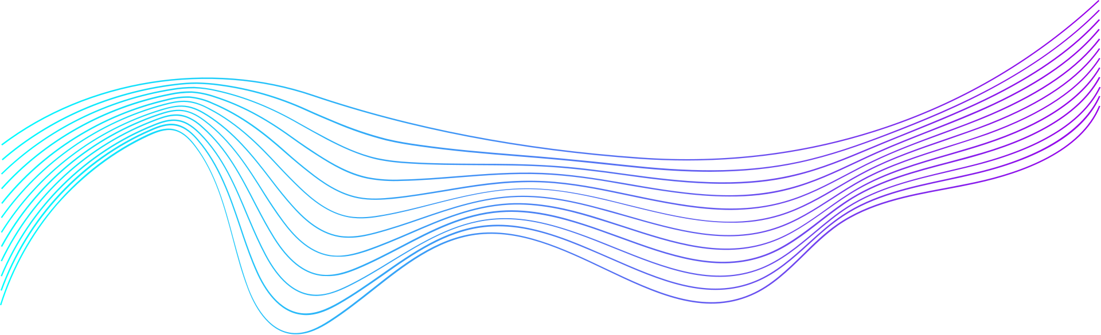
TERMINAL STRING STYLING & CHALK LIBRARY
  Mercy Wamanga
  Ephrance Kisakye
  Theo Sugiira
  Opini Isaac
  Derrick Ainembabazi
  Mutesi Joanne
  Sarah Olila Apunyo
  Okwalinga Samuel

Slide 2

AGENDA
  What is terminal string styling?
  Need for terminal string styling.
  Chalk library
  Demo

Slide 3
WHAT IS TERMINAL STRING SYTLING?
Because most terminal applications or tools are single colored in nature, terminal string styling helps us apply colors for easier readability.

Slide 4
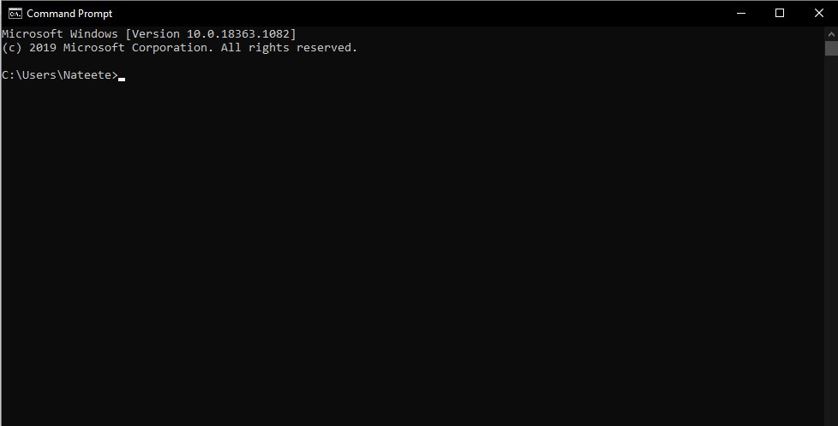
NEED FOR TERMINAL STRING SYTLING
  Most terminal applications or tools in NodeJS are single colored in nature.
  Consoles look boring.
  Readability is difficult: Errors, success messages all have similar colors.

Slide 5
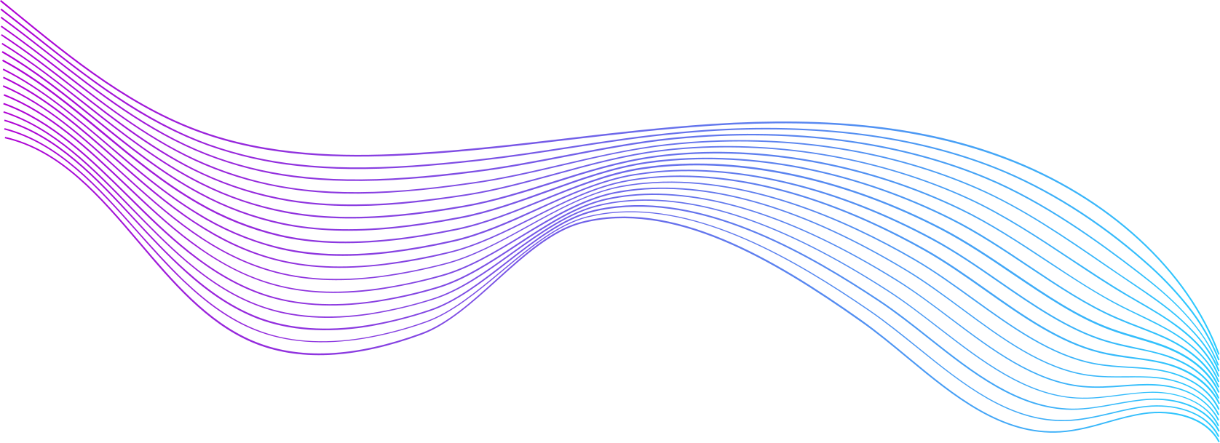
CHALK
Chalk is a node js library that allows us to customize how text gets printed to the console when working with node.
You can style your application terminal output strings in various colors and styles, making it more readable and colorful.

Slide 6
ORIGIN STORY
There used to be colors.js.
Serious deficiencies like extending String.prototype which causes all kinds of problems and the package is unmaintained.
Other packages also exist but Chalk is a clean and focused alternative.

Slide 7
HIGHLIGHTS
  Expressive API
  Highly performant
  Ability to nest styles
  256/Truecolor color support
  Auto-detects color support
  Doesn't extend String.prototype
  Clean and focused
  Actively maintained
  Used by ~50,000 packages as of January 1, 2020 e.g. eslint, node-sass,
tslint among others (https://www.npmjs.com/).

Slide 8
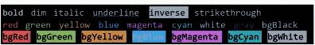
DEFAULT

Slide 9
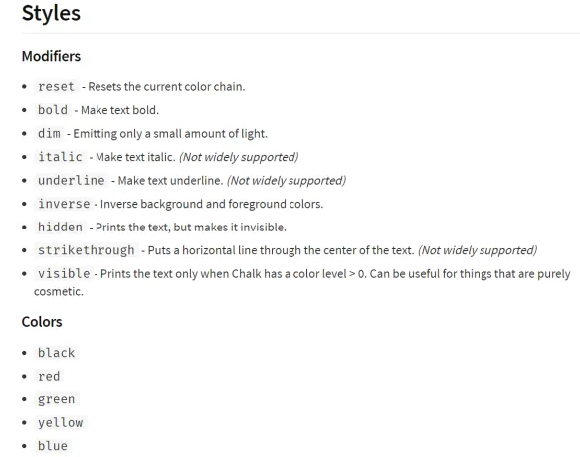
OVERIDING

Slide 10
DEMO

Slide 11
INSTALLATION
npm install chalk (installs locally on the project)
OR
npm install -g chalk (installs globally)
Also checkout the github repo, it is open source:
https://github.com/chalk/chalk

Slide 12
Usage is short and simple.
const chalk = require('chalk');
console.log(chalk.blue('Hello world!'));

Slide 13
const chalk = require('chalk');
const log = console.log;
// Combine styled and normal strings
log(chalk.blue('Hello') + ' World' + chalk.red('!'));
// Compose multiple styles using the chainable API
log(chalk.blue.bgYellow.bold('Hello world!'));
// Pass in multiple arguments
log(chalk.blue('Hello', 'World!', 'Foo', 'bar', 'biz', 'baz'));
// Nest styles
log(chalk.red('Hello', chalk.underline.bgBlue('world') + '!'));
// Nest styles of the same type even (color, underline, background)
log(chalk.green(
'I am a green line ' +
chalk.blue.underline.bold('with a blue substring') +
' that becomes green again!'
));
Detailed Example
const chalk = require('chalk');
const log = console.log;
// Combine styled and normal strings
log(chalk.blue('Hello') + ' World' + chalk.red('!'));
// Compose multiple styles using the chainable API
log(chalk.blue.bgYellow.bold('Hello world!'));
// Pass in multiple arguments
log(chalk.blue('Hello', 'World!', 'Foo', 'bar', 'biz', 'baz'));
// Nest styles
log(chalk.red('Hello', chalk.underline.bgBlue('world') + '!'));
// Nest styles of the same type even (color, underline, background)
log(chalk.green(
'I am a green line ' +
chalk.blue.underline.bold('with a blue substring') +
' that becomes green again!'
));

Slide 14
const chalk = require('chalk');
const log = console.log;
// Combine styled and normal strings
log(chalk.blue('Hello') + ' World' + chalk.red('!'));
// Compose multiple styles using the chainable API
log(chalk.blue.bgYellow.bold('Hello world!'));
// Pass in multiple arguments
log(chalk.blue('Hello', 'World!', 'Foo', 'bar', 'biz', 'baz'));
// Nest styles
log(chalk.red('Hello', chalk.underline.bgBlue('world') + '!'));
// Nest styles of the same type even (color, underline, background)
log(chalk.green(
'I am a green line ' +
chalk.blue.underline.bold('with a blue substring') +
' that becomes green again!'
));
THANK YOU

